Slide 1
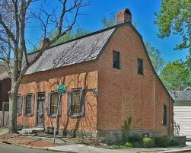
Dutch Architecture
By Jarrod Lawson

Slide 2
History of Dutch Architecture
built around the 1700's
usually located in the New York Hudson valley area

Slide 3
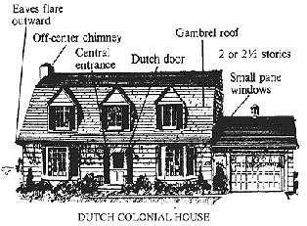
Features of Dutch Architecture
matching chimneys
Dutch doors (top and bottom open independently
Gambreled roofs
2-2 1/2 stories

Slide 4
Materials of Dutch Architecture
used a lot of stone or brick
also heavy use of wood

Slide 5
Sources
About.com. (2013). retrieved august 6, 2013. http://architecture.about.com/od/periodsstyles/ig/House-Styles/Dutch-Colonial.htm
expatica. (2012). retrieved august 6, 2013. http://www.expatica.com/nl/leisure/arts_culture/an-introduction-to-dutch-colonial-architecture_12867.html

